Slide 1





ONLINE BANKING
SYSTEM
Team 1

Slide 2

AIM
To build a web application which is Remote, Secure and User-friendly.
A platform that could overcome the problems in the existing manual banking system.

Slide 3
OBJECTIVES
01
02
03
04
Enabling ease of checking balance and transaction of money to or from their accounts by the customers.
To create a remote banking platform where customers can update their information.
Show the bank balance of the customer after every transaction.
Provide comfortable and user-friendly experience to the customer.

Slide 4

FUNCTIONALITIES
Registering and Logging into the Bank accounts
Online Transactions
Transaction Details and Monitoring by the Admin
Automatic Balance updates.
Tracking and Displaying the user information.
Updating the user information.

Slide 5
SYSTEM REQUIREMENTS
Software Tools
Spring Boot (3.X version)
React JS (16.X version)
Java Development Kit (JDK 1.8 or above)
Node.js
IDE (Integrated Development Environment) - e.g., Eclipse, Visual Studio Code
Hardware Requirements
Processor: Intel Core i5 or equivalent
RAM: Minimum 8 GB
Storage: At least 20 GB of free disk space
Operating System: Windows, macOS, or Linux
Stable internet connection

Slide 6

ARCHITECTURE

Slide 7
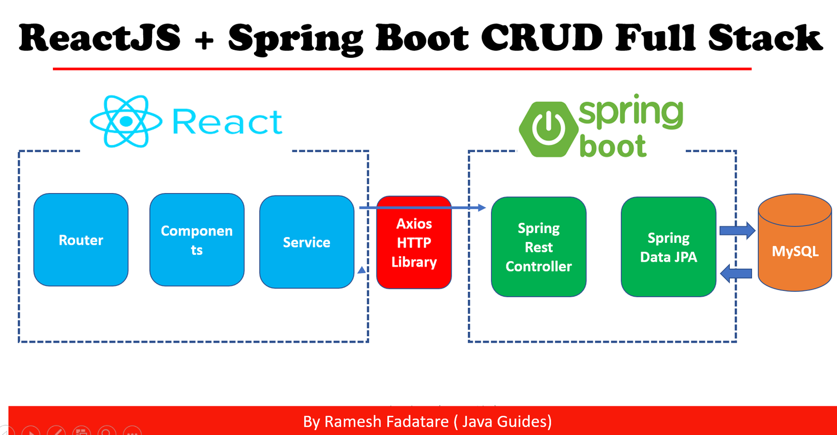

Slide 8












TECHSTACK

Slide 9

PROJECT
MODULES
Register & Login
Home Page
Login Page
Register Page
Dashboard
Transactions
Customer Details
Admin
Admin login
Transactions List

Slide 10
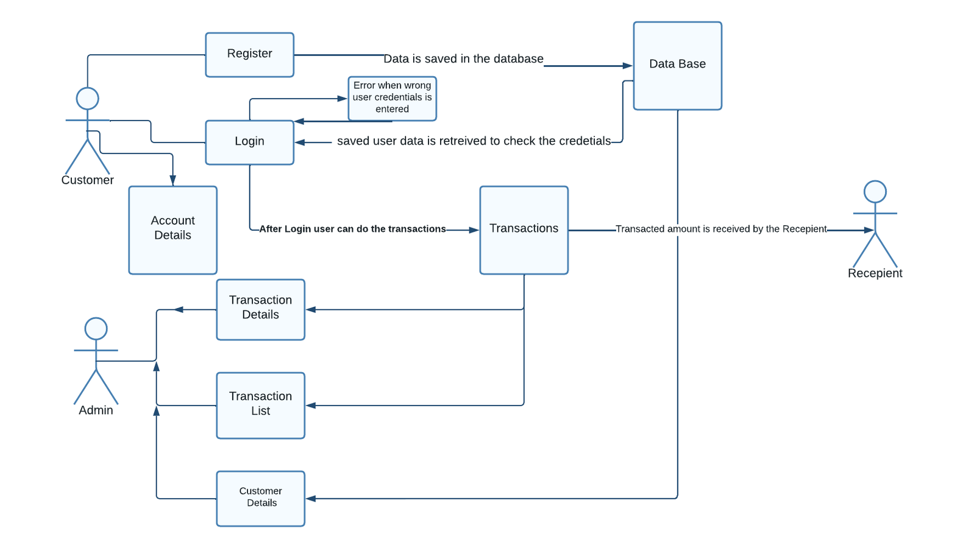

SEQUENCE DIAGRAM
Customer 2

Slide 11
Android app for the users.
Scaling of the application.
Adding more features to the dashboard for a personalized experience.
Giving suggestions/insights based upon the transaction history
Improve security using two-factor authentication
WHAT'S NEXT

Slide 12
TESTING

Slide 13
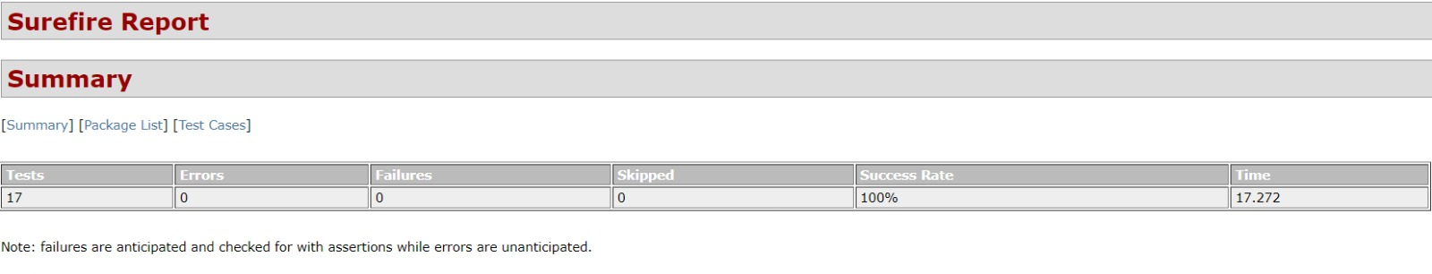
UNIT TESTING

Slide 14
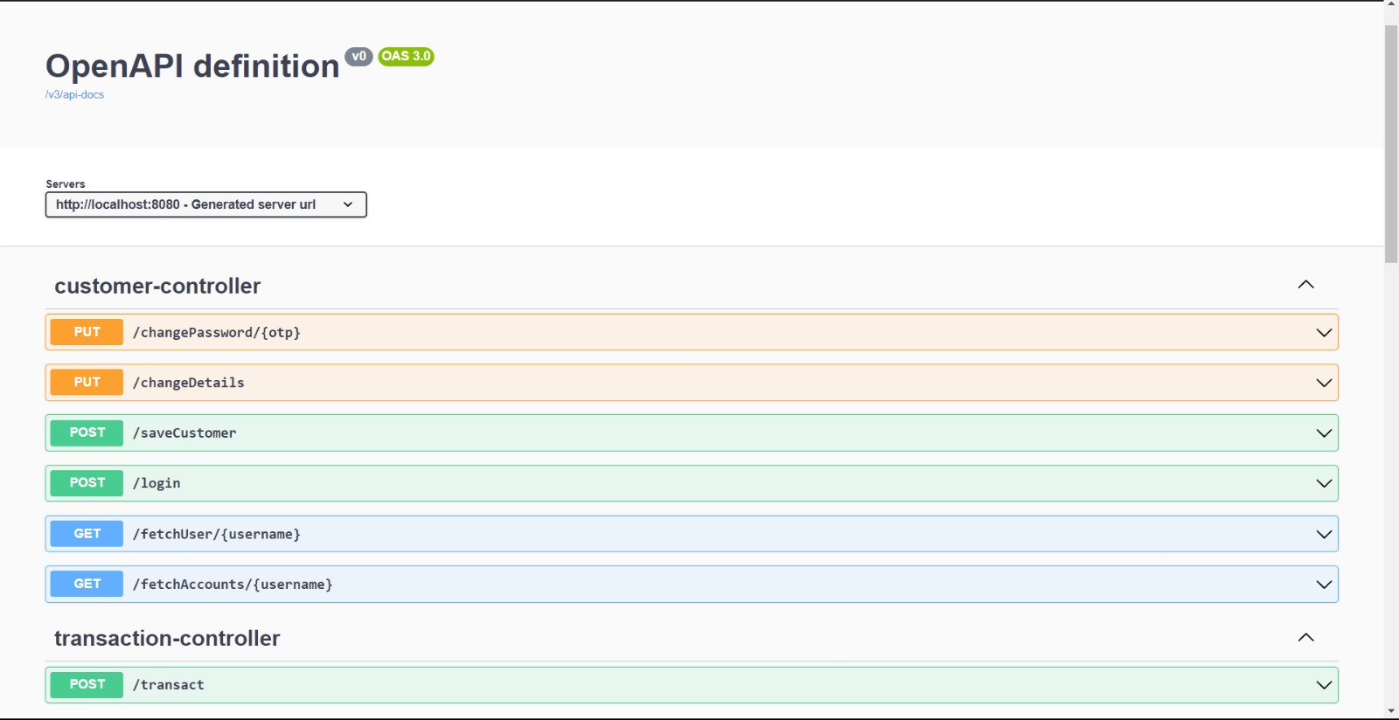
SWAGGER UI

Slide 15
PROJECT
SCREENSHOTS

Slide 16
CLIENT
SIDE

Slide 17


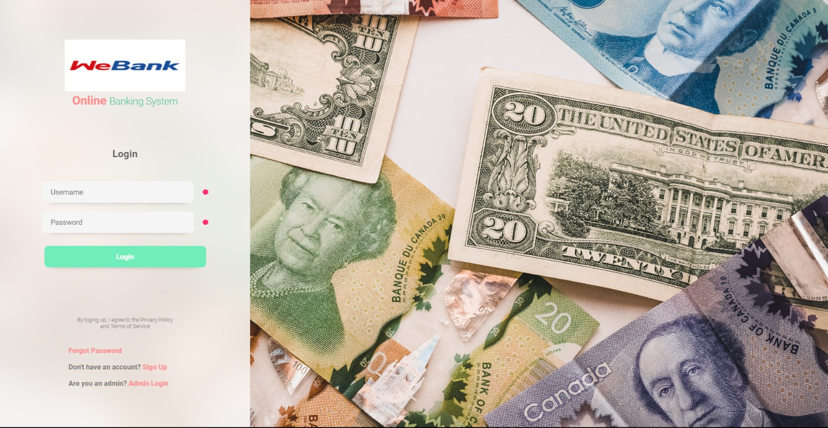
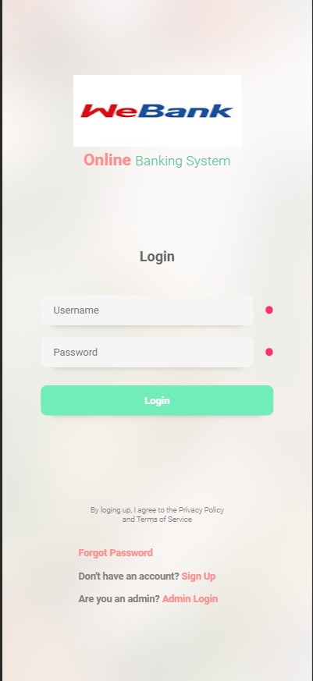
LOGIN

Slide 18
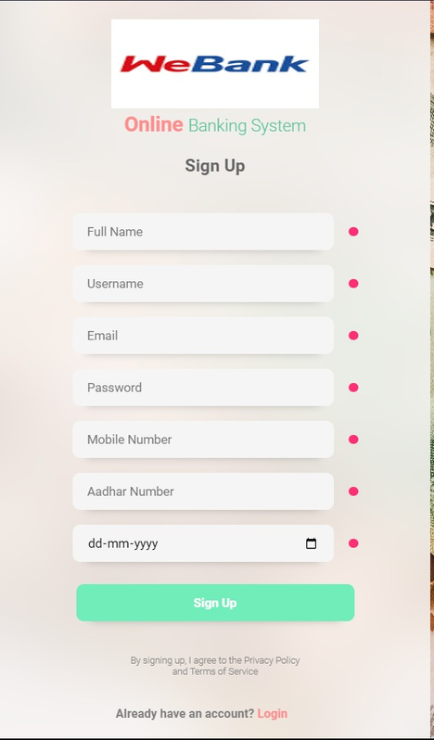
SIGN UP
PAGE

Slide 19
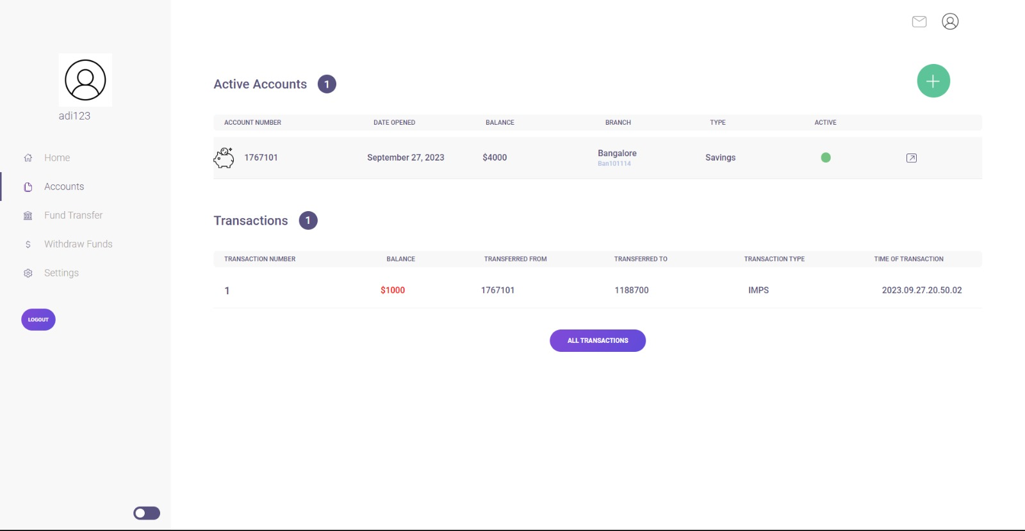
USER
DASHBOARD

Slide 20
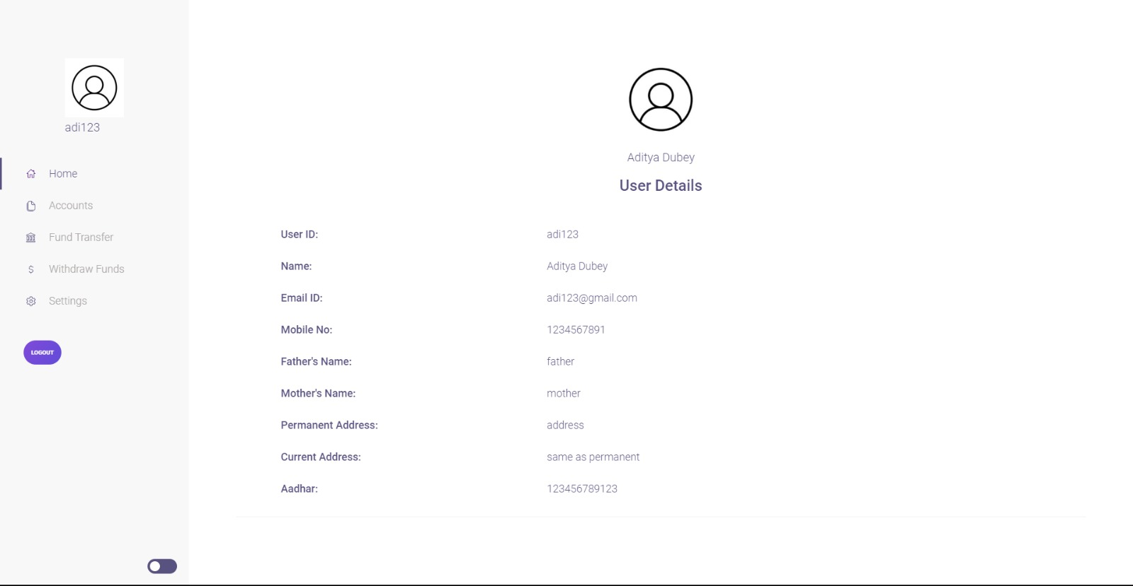
USER
PROFILE

Slide 21
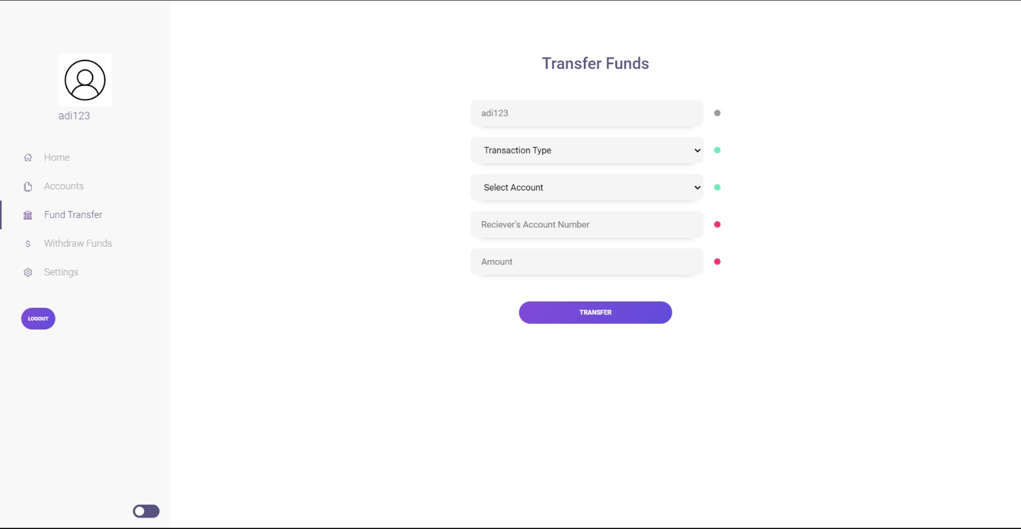
TRANSFER
FUNDS

Slide 22
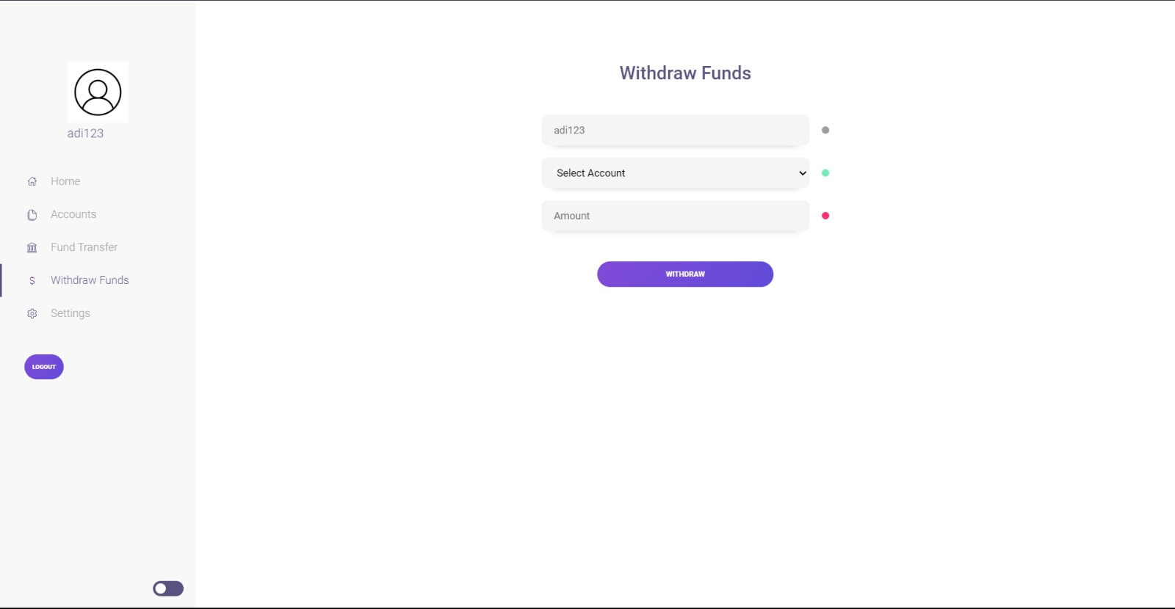
WITHDRAW
FUNDS

Slide 23
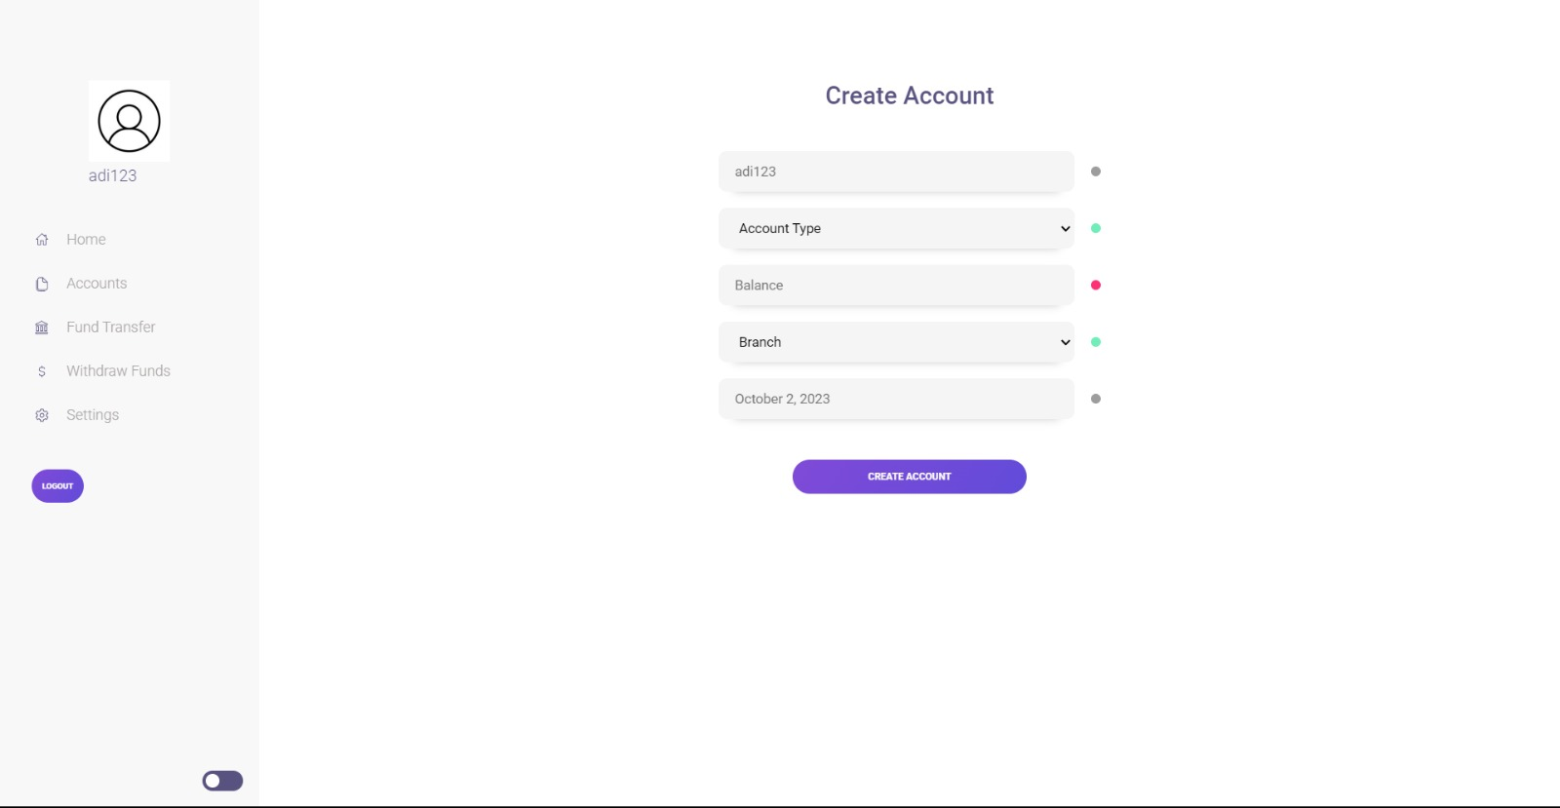
CREATE
ACCOUNT

Slide 24
ADMIN
SIDE

Slide 25
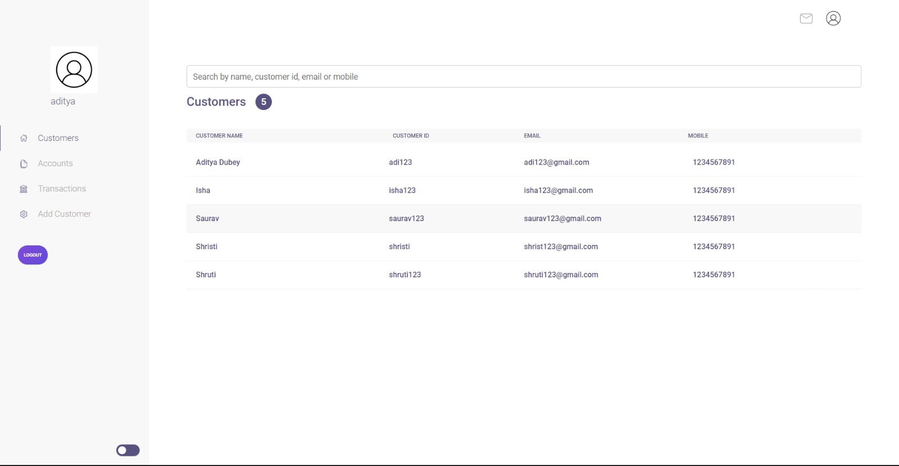
ADMIN
DASHBOARD

Slide 26
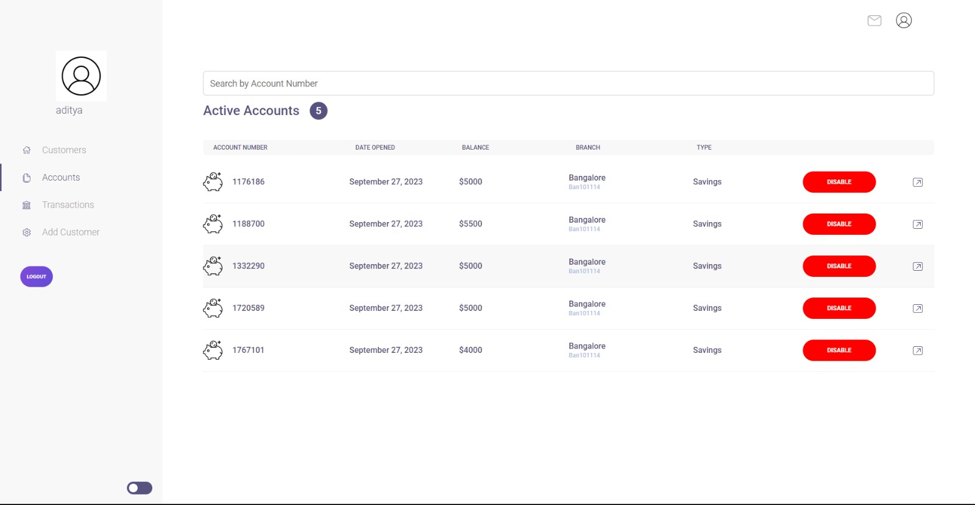
ADMIN
ACCOUNT LIST

Slide 27
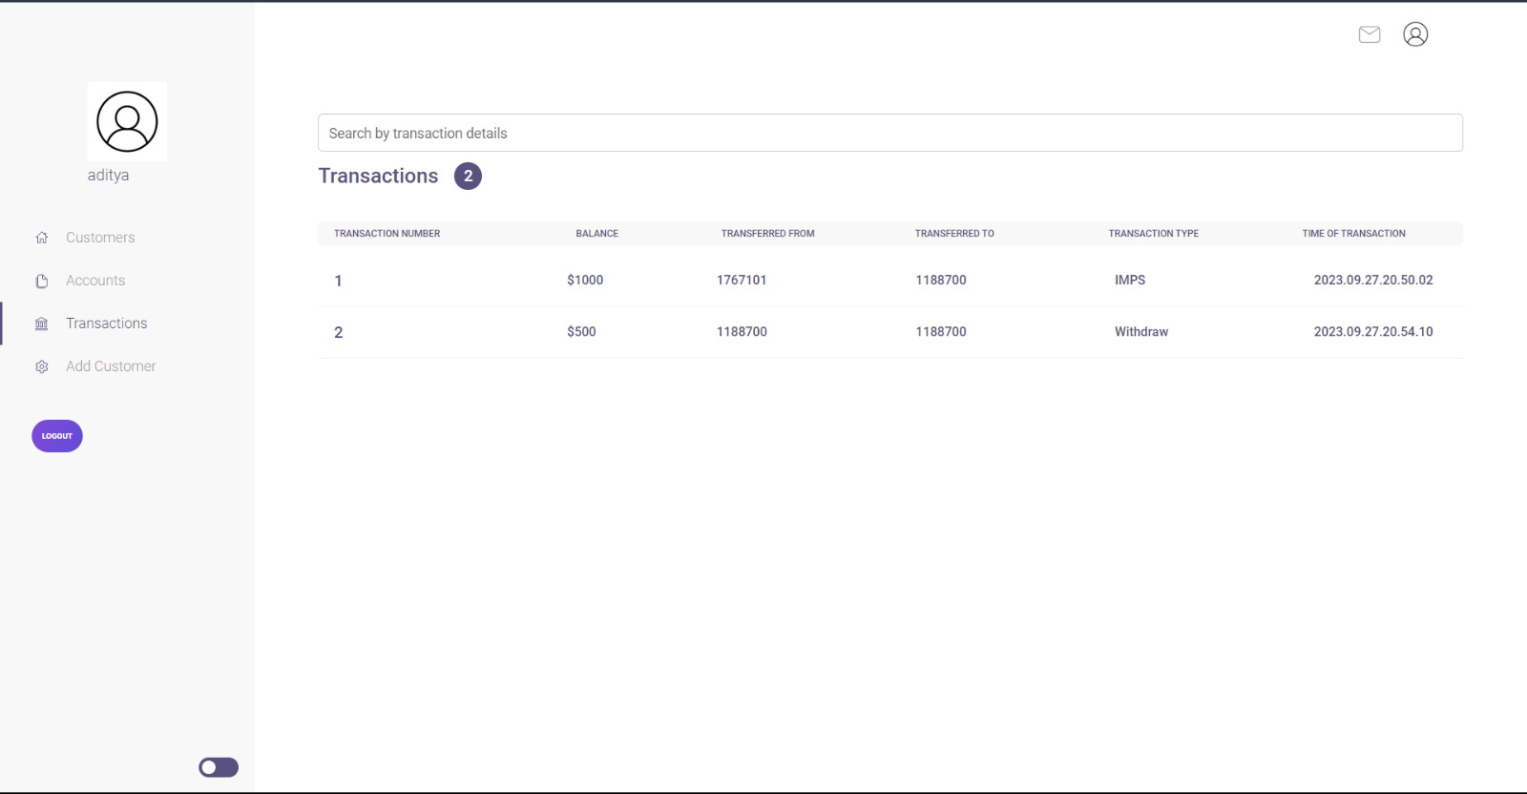
ADMIN
TRANSACTION LIST

Slide 28
ADMIN
REGISTER NEW CUSTOMER

Slide 29
DEMO

Slide 30


THANK
YOU!

